Slide 1

Managing Variables and Secrets: An Overview
In today's development environments, proper management of variables and secrets is critical for maintaining security and operational efficiency.
Variables: Store configuration data like environment settings and build parameters
Secrets: Handle sensitive information such as passwords, API tokens, and certificates
Protection: Require special safeguards to prevent unauthorized access
When secrets are exposed, organizations face serious consequences:
Data breaches and system compromises
Unauthorized access to critical infrastructure
Compliance violations and regulatory penalties
Loss of customer trust and reputation damage
Implementing automated secret management provides significant benefits:
Reduces human error in handling sensitive data
Strengthens overall security posture
Ensures consistent protection across environments
Enables audit trails and compliance reporting

Slide 2
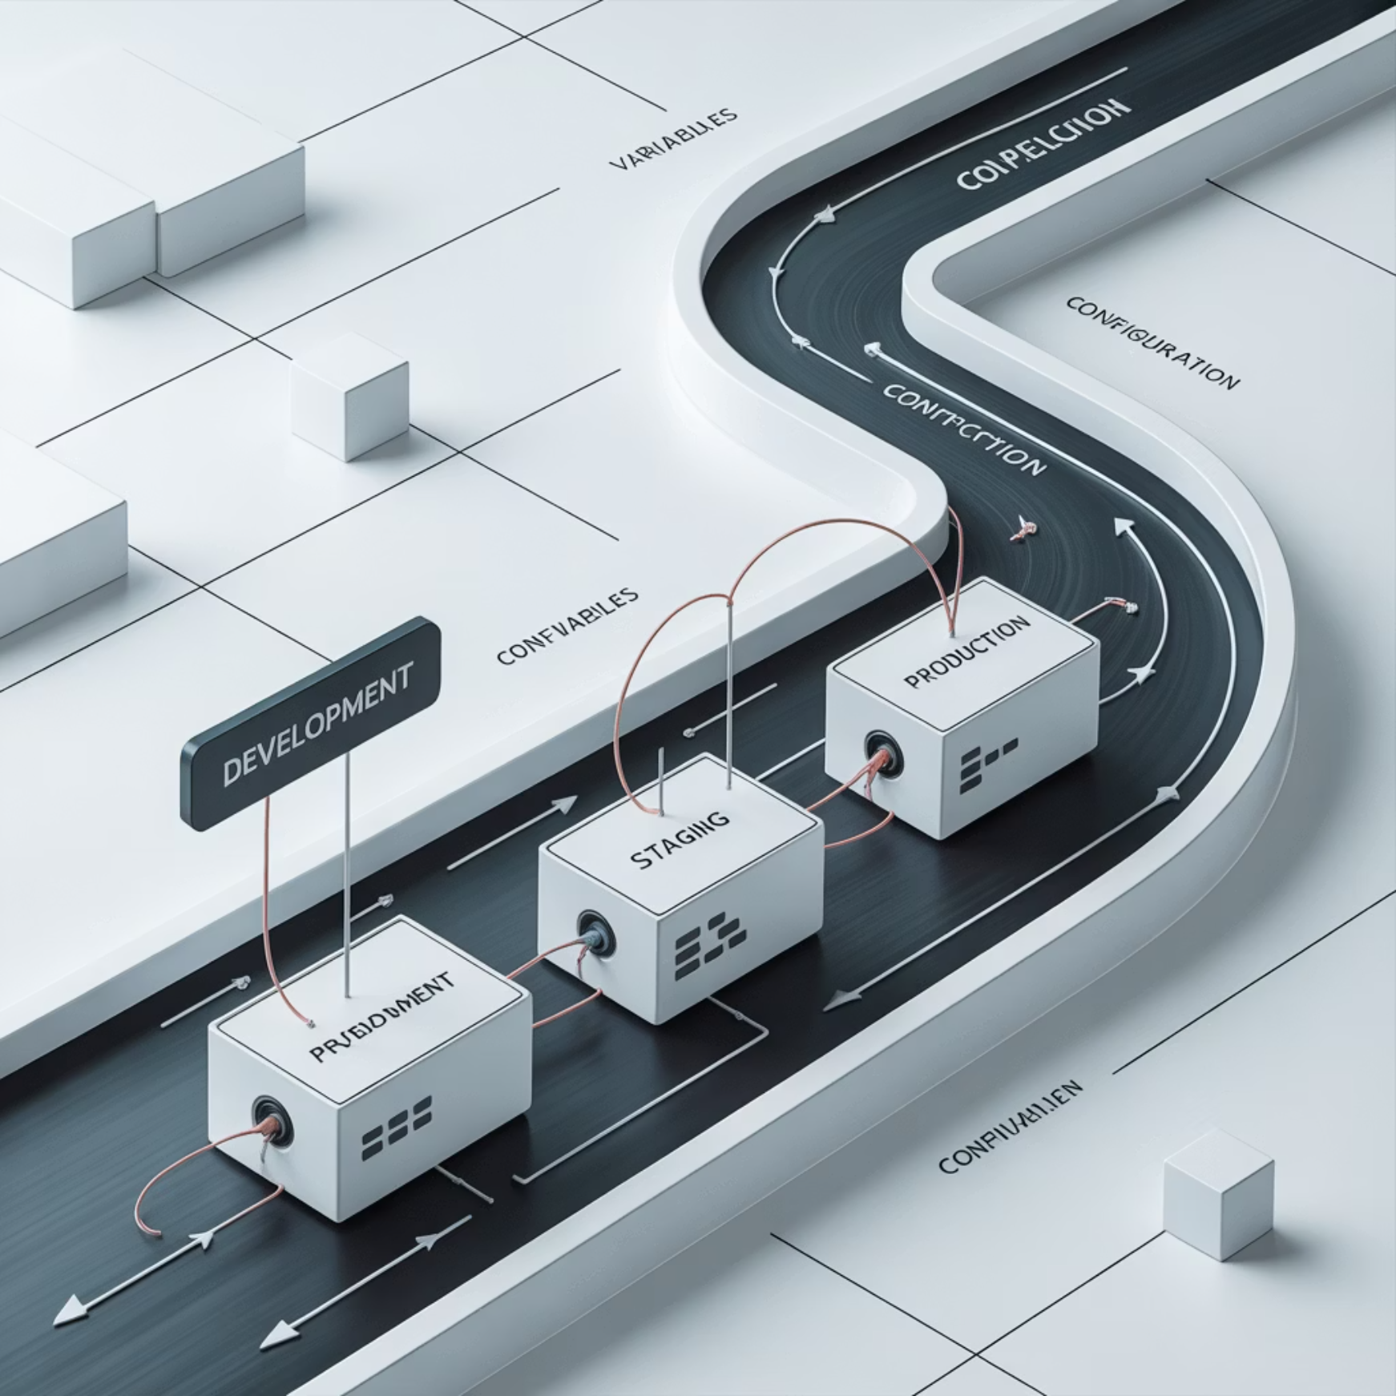


Types of Variables in CI/CD
Variables in continuous integration and deployment pipelines serve as essential key-value pairs that control how your automation works. They come in two primary categories:
1
Standard Variables
Configuration values that help customize pipeline behavior:
Environment settings and paths
Build parameters and flags
URLs and endpoints
Non-sensitive configuration data
2
Secret Variables
Sensitive information requiring special protection:
Passwords and authentication tokens
API keys and access credentials
Encryption keys and certificates
Database connection strings
Variables enable consistent deployment across environments:
Development environment customization
Staging environment configuration
Production deployment settings
Context-specific requirements adaptation

Slide 3


Protected Variables
Key Features:
Only accessible when pipelines run on protected branches or tags
Ideal for production credentials that should never be exposed to feature branches
Prevents accidental exposure in non-production environments
Enforces separation between development and production access
Protected variables create a secure boundary between production environments and development work, reducing the risk of credential leakage.
Protected variables provide an additional layer of security by restricting access to specific branches or tags in your repository.

Slide 4








Masked Variables
Hide Values in Logs
Configuration Options
Displays [MASKED] instead of actual values in pipeline job logs, preventing casual observation of sensitive data.
Can be set at project, group, or admin level depending on your organizational needs and security policies.
Limitations
Technical Requirements
Not completely foolproof - values can still be exposed if debugging features are enabled or output is manipulated.
Must be single-line values with at least 8 characters, using a limited character set to enable reliable masking.

Slide 5


Limitations of Masked Variables
While masked variables provide a layer of protection, they have important limitations that security-conscious teams must understand:
Log Obfuscation Only
Masking only replaces the value in logs, but the actual value remains accessible to the internal process and any scripts it runs.
Potential Exposure
Malicious code could intentionally print secret values in modified formats that bypass masking patterns (e.g., inserting spaces, encoding).
Higher Security Needs
For truly sensitive secrets, external vault services like HashiCorp Vault or cloud provider secret managers provide stronger protection.
Understanding these limitations is crucial for implementing appropriate security measures for your most sensitive credentials.

Slide 6
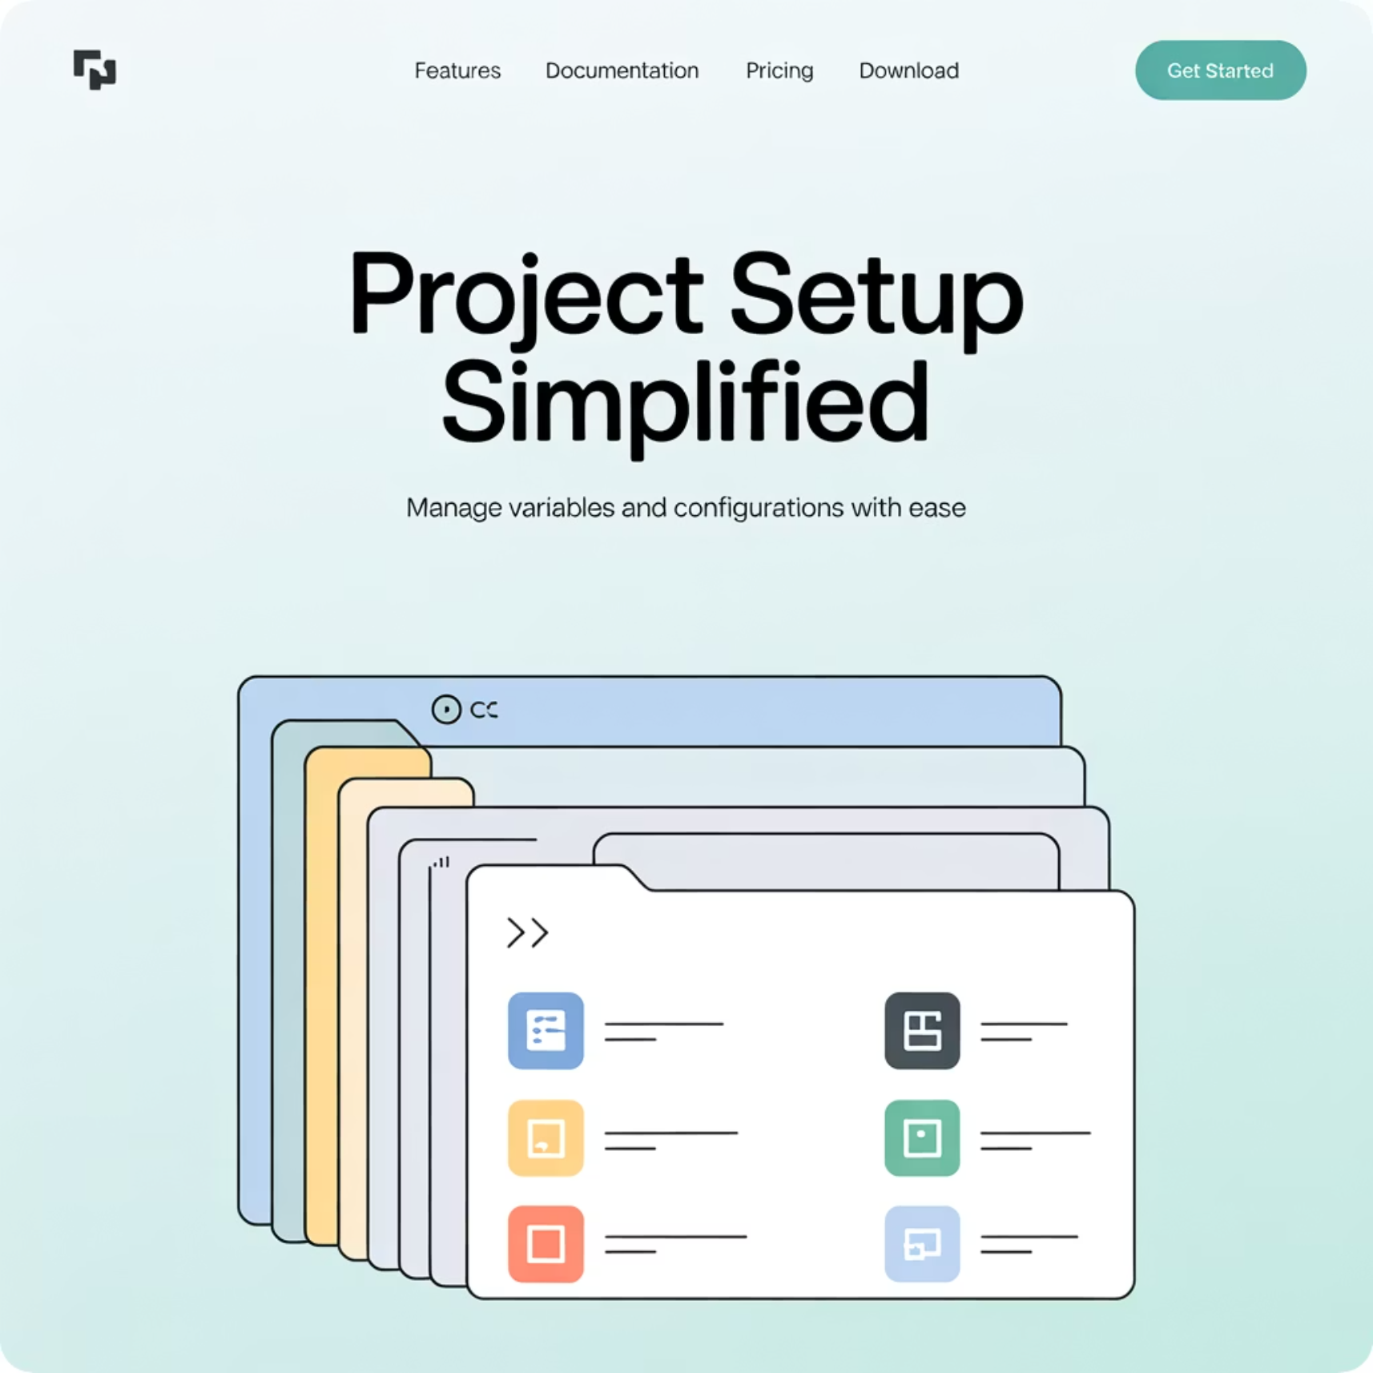



Project-Level Variables
Project Scope
Only accessible within the specific project where they're defined, keeping configuration isolated.
Override Capability
Can override group-level variables with the same name, allowing customization for specific projects.
Environment Control
Perfect for project-specific settings like deployment targets, feature flags, and application-specific secrets.
Project-level variables provide configuration specific to a single repository or application, giving you granular control over your deployment environment.

Slide 7



Group-Level Variables
Organization
Top-level groups for broad organizational settings like compliance and security standards.
Division/Team
Mid-level groups for team-specific configurations shared across related projects.
Project
Inherited variables available to all pipelines in the project unless overridden.
Group-level variables enable centralized management of configuration across multiple projects. Update a value once at the group level, and all child projects automatically use the new value—perfect for shared infrastructure credentials, common endpoints, or organization-wide settings.

Slide 8

Best Practices for Managing Variables and Secrets
Automate Secret Management
Use dedicated tools like HashiCorp Vault, AWS Secrets Manager, or Azure Key Vault to handle secret rotation, auditing, and access control.
Implement Regular Rotation
Frequently update secrets (every 30-90 days) to minimize the risk window if credentials are compromised.
Apply Least Privilege
Restrict variable access to only the branches, environments, and team members who absolutely need it.
Combine Protection Methods
Use both masking and protection together for sensitive values, understanding the limitations of each approach.
Remember that proper secret management is a continual process, not a one-time setup. Regular audits and improvements to your variable strategy are essential components of a mature security posture.

